Slide 1
The IMDB in action uses of the longitudinal immigration database from The community data program Mercedes Labelle, Nov. 9, Sudbury, on

Slide 2
About Northern Policy Institute
Northern Policy Institute is Northern Ontario’s independent, evidence-driven think tank
We perform research, analyze data, and disseminate ideas
Our permanent offices are in Thunder Bay, Sudbury, and Kirkland Lake
Our mission is to enhance Northern Ontario's capacity to take the lead position on socio-economic policy that impacts our:
Communities,
Province,
Country, and
World.
https://www.northernpolicy.ca/
Notes:
Northern Policy Institute is Northern Ontario’s independent, evidence-driven think tank. We perform research, analyze data, and disseminate ideas. Our permanent offices are in Thunder Bay, Sudbury, and Kirkland Lake. Our mission is to enhance Northern Ontario's capacity to take the lead position on socio-economic policy that impacts our communities, our province, our country, and our world.
I’m Mercedes Labelle, the Senior Policy Analyst at NPI based out of Sudbury, ON. I lead our community capacity team, which covers our population growth projects. As such, I work frequently with the LIPs and RIF in Northern Ontario, as well as the Rural and Northern Immigration Pilot coordinators, to measure and assess immigration levels and impacts
In fact, NPI has a three-year partnership with FedNor to monitor and assess the impacts of the Rural and Northern Immigration Pilot in Northern Ontario communities

Slide 3
Example: All Roads Lead Home
Purpose: establish a baseline assessment of immigration trends in Northern Ontario communities, which can be used to evaluate immigration programs, such as the RNIP, and other potential future newcomer programs
Indicators analyzed include:
Immigrant characteristics
Income
Economic outcomes
Mobility
ICARE
https://www.northernpolicy.ca/all-roads-lead-home
Notes:
Two examples of work we’ve done using the IMDB and other CDP datasets include: All Roads Lead Home paper series
Premise - establish baseline understanding of current immigration trends and demographic characteristics to engage in evidence-based decision-making that will positively impact Northern Ontario communities. We wrote reports for each of Big Five’ cities in Northern Ontario. 5 CMA/CAs in Northern Ontario (RNIP/LIP communities) – North Bay, Timmins, Sault Ste. Marie, Thunder Bay, and Sudbury
These assessments can be used to evaluate immigration pilot programs, such as the Rural and Northern Immigration Pilot, and potential future newcomer programs
- Used multiple data sources, such as the IMDB, target group profiles, taxfiler data, and IRCC admission data
Indicators:
Immigrant characteristics
Admission of immigrants by country of citizenship
Sex of immigrants
Age at landing
Language spoken
Immigration stream
Country of birth
Income
Median and mean total income
Median employment earnings
Economic outcomes
Employment / participation rates
Mobility/retention rates
Settlement service clients by service type (originally we requested this data from IRCC, but it’s now available through the IMDB – and I know Mike will be going over this shortly)

Slide 4
Example: Taking Aim
This series of papers projects how many future French-speaking and Francophone migrants should be targeted to maintain the current levels in Northern Ontario for these two groups.
Taxfiler Migration Estimates data was used to calculate community-specific retention rates, which were used to project out-migration
Other datasets used
include TGP of
Francophones, TGP of
French-Speakers, TGP of
by Age Groups
https://www.northernpolicy.ca/taking-aim
Notes:
Though some of the data used to create these reports are, in theory, offered through the IMDB, the numbers for the geographies we wrote the reports for were too low (ie suppressed) so we did use proxy measures
Done for the Big 5 communities in Northern Ontario and the 11 CDs
This series of papers projects how many future French-speaking and Francophone migrants should be targeted to maintain the current levels in Northern Ontario for these two groups.
Though French-speaking immigrant mobility data was suppressed (thus not useable for this project), if it is available for your community on CDP, it would help increase the accuracy of the projections (and make your life a little easier)

Slide 5
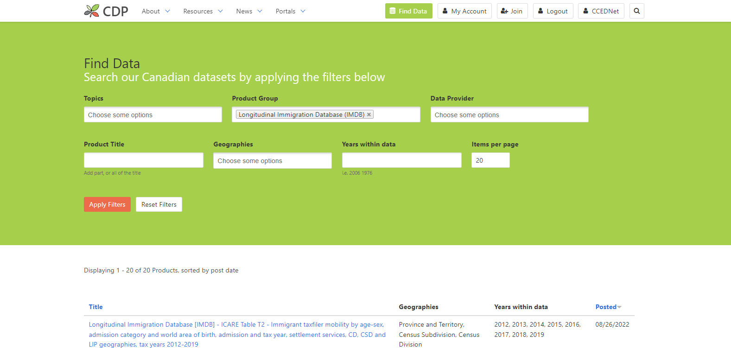
Community Data Program

Slide 6
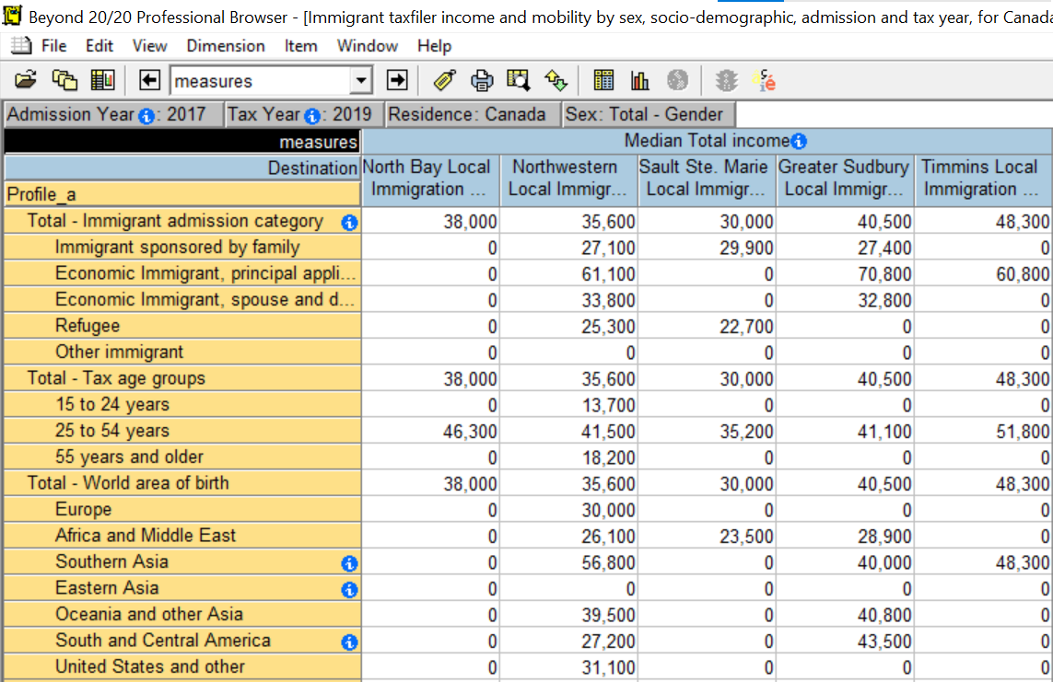
IMDB Table 1: Immigrant taxfiler income and mobility
Notes:
by sex, socio-demographic profile, admission year and tax year, for Canada, select provinces/territories and partnerships - LIP boundaries
When evaluating a work experience-based program like the RNIP, that will potentially have direct impacts Economic migrants, it is useful to have stream-specific data to better assess program impacts
Here we are looking at median total income ($) for immigrants living within the five NOLIP boundaries – specifically those that filed taxes in the 2019 tax year
Economic outcomes, such as income and involvement in the labour market, typically differ depending on the immigration stream the immigrant followed
This table includes the taxfiler’s income from taxable sources (for example, all market incomes such as employment earnings) as well as non-taxable sources (for example, government transfers such as social assistance or child benefits).
In most instances where data is available, median total income is higher among economic principal applicants than other admission streams

Slide 7
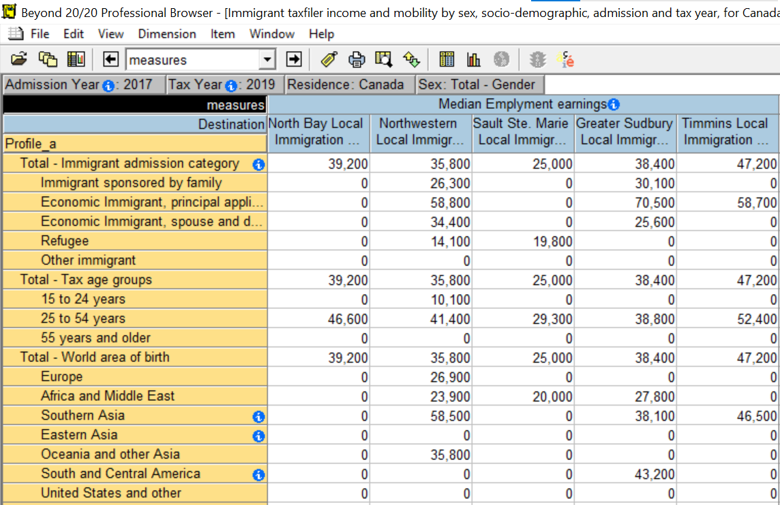
IMDB Table 1: Immigrant taxfiler income and mobility
Notes:
Here we are looking at median employment earnings for immigrants living within the five NOLIP boundaries
Employment income is the sum of wages, salaries, commissions, and self-employment income – it does not include non-taxable benefits like social assistance

Slide 8
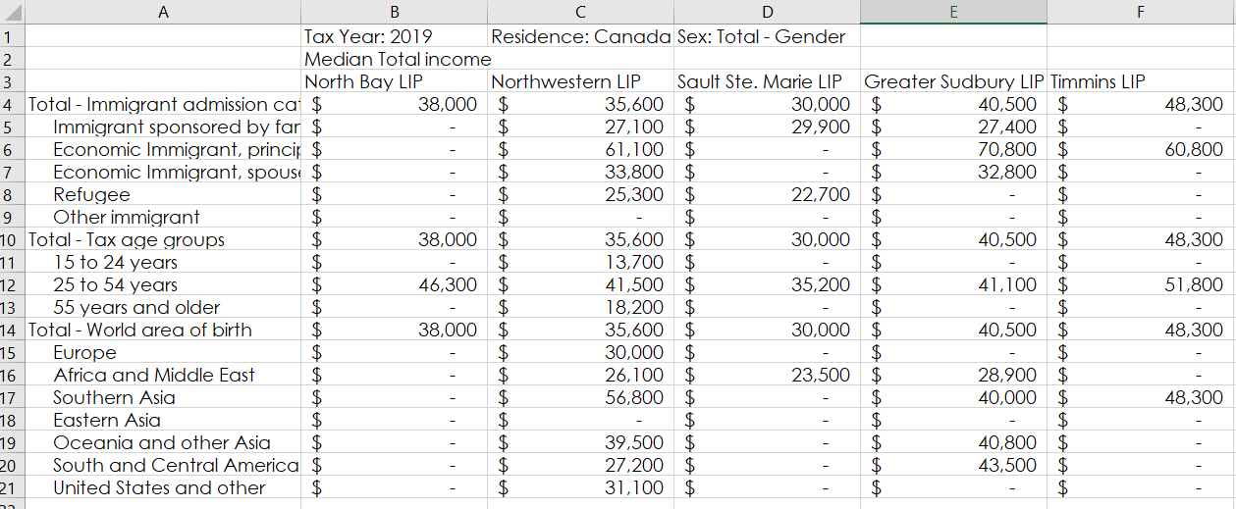
Export to Excel – Median Total Income
Notes:
Can export data from beyond2020 into excel once you have it cleaned and showing the indicators and geography you want

Slide 9
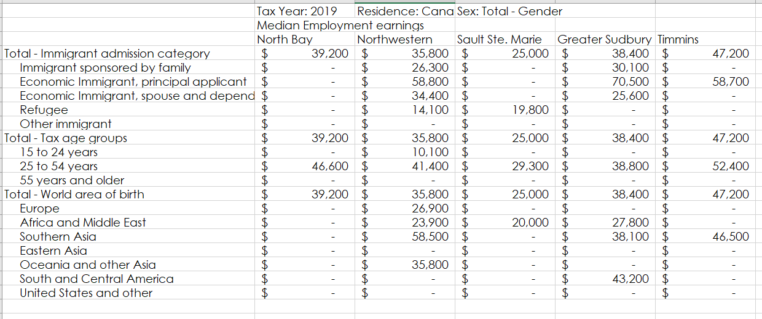
Export to Excel – Median Employment Earnings

Slide 10
Source: IMDB Table 1
Note: North Bay LIP data is unavailable due to data suppression.

Slide 11
Source: IMDB Table 1
Note: North Bay LIP data is unavailable due to data suppression.
Notes:
Comparing both median total income and median employment income, there isn’t too much of a discrepancy in economic immigrants’ incomes
We do see some difference between the two income measures in other immigration streams, like those of refugees’ and spouse and dependents’, which could indicate a higher use of social assistance

Slide 12
Thank you. Marsee. ᑭᓇᓈᐢᑯᒥᑎᐣ Merci. Miigwech.
1 (807) 343-8956 | info@northernpolicy.ca
www.northernpolicy.ca
/NorthernPolicy

Slide 13
La BDIM en action Emplois de la Base de données longitudinales sur l'immigration à partir du CDP (Community Data Program) Mercedes Labelle, le 9 novembre, Sudbury (Ontario)

Slide 14
À propos de l’Institut des politiques du Nord
L’Institut des politiques du Nord est le groupe de réflexion indépendant et fondé sur des preuves du Nord de l'Ontario.
Nous effectuons des recherches, analysons des données et diffusons des idées.
Nos bureaux permanents se situent à Thunder Bay, Sudbury et Kirkland Lake.
Notre mission est d'améliorer la capacité du Nord de l'Ontario à prendre la tête des politiques socio-économiques qui ont un impact sur :
nos communautés,
notre province,
notre pays,
et le reste du monde.
https://www.northernpolicy.ca/
Notes:
Northern Policy Institute is Northern Ontario’s independent, evidence-driven think tank. We perform research, analyze data, and disseminate ideas. Our permanent offices are in Thunder Bay, Sudbury, and Kirkland Lake. Our mission is to enhance Northern Ontario's capacity to take the lead position on socio-economic policy that impacts our communities, our province, our country, and our world.
I’m Mercedes Labelle, the Senior Policy Analyst at NPI based out of Sudbury, ON. I lead our community capacity team, which covers our population growth projects. As such, I work frequently with the LIPs and RIF in Northern Ontario, as well as the Rural and Northern Immigration Pilot coordinators, to measure and assess immigration levels and impacts
In fact, NPI has a three-year partnership with FedNor to monitor and assess the impacts of the Rural and Northern Immigration Pilot in Northern Ontario communities

Slide 15
Exemple : Tous les chemins mènent à la maison
Objectif : établir une évaluation de base des tendances en matière d’immigration dans les communautés du Nord de l'Ontario, et l'utiliser pour évaluer les programmes d’immigration, comme le PPICRN et les futurs programmes pour les nouveaux arrivants.
Les indicateurs analysés incluent :
Les caractéristiques de l'immigration
Le revenu
Les résultats économiques
La mobilité
L'iEDEC
https://www.northernpolicy.ca/all-roads-lead-home-fre
Notes:
Two examples of work we’ve done using the IMDB and other CDP datasets include: All Roads Lead Home paper series
Premise - establish baseline understanding of current immigration trends and demographic characteristics to engage in evidence-based decision-making that will positively impact Northern Ontario communities. We wrote reports for each of Big Five’ cities in Northern Ontario. 5 CMA/CAs in Northern Ontario (RNIP/LIP communities) – North Bay, Timmins, Sault Ste. Marie, Thunder Bay, and Sudbury
These assessments can be used to evaluate immigration pilot programs, such as the Rural and Northern Immigration Pilot, and potential future newcomer programs
- Used multiple data sources, such as the IMDB, target group profiles, taxfiler data, and IRCC admission data
Indicators:
Immigrant characteristics
Admission of immigrants by country of citizenship
Sex of immigrants
Age at landing
Language spoken
Immigration stream
Country of birth
Income
Median and mean total income
Median employment earnings
Economic outcomes
Employment / participation rates
Mobility/retention rates
Settlement service clients by service type (originally we requested this data from IRCC, but it’s now available through the IMDB – and I know Mike will be going over this shortly)

Slide 16
Exemple : Viser juste
Cette série d’articles projette combien de futurs migrants parlant le français et de migrants francophones devraient être ciblés pour maintenir les niveaux actuels dans le Nord de l’Ontario pour ces deux groupes.
On a utilisé les données Taxfiler Migration Estimates pour calculer les taux de rétention propres à chaque communauté, que l'on a ensuite utilisés pour projeter la migration.
Les autres ensembles de données
employés incluent les profils
des groupes cibles (TGP)
des francophones, les TGP
des personnes parlant le
français et les TGP par
groupes d'âge.
https://www.northernpolicy.ca/ambition
Notes:
Though some of the data used to create these reports are, in theory, offered through the IMDB, the numbers for the geographies we wrote the reports for were too low (ie suppressed) so we did use proxy measures
Done for the Big 5 communities in Northern Ontario and the 11 CDs
This series of papers projects how many future French-speaking and Francophone migrants should be targeted to maintain the current levels in Northern Ontario for these two groups.
Though French-speaking immigrant mobility data was suppressed (thus not useable for this project), if it is available for your community on CDP, it would help increase the accuracy of the projections (and make your life a little easier)

Slide 17
Community Data Program

Slide 18
Tableau 1 de la BDIM : Revenu des déclarants immigrants et mobilité
Notes:
by sex, socio-demographic profile, admission year and tax year, for Canada, select provinces/territories and partnerships - LIP boundaries
When evaluating a work experience-based program like the RNIP, that will potentially have direct impacts Economic migrants, it is useful to have stream-specific data to better assess program impacts
Here we are looking at median total income ($) for immigrants living within the five NOLIP boundaries – specifically those that filed taxes in the 2019 tax year
Economic outcomes, such as income and involvement in the labour market, typically differ depending on the immigration stream the immigrant followed
This table includes the taxfiler’s income from taxable sources (for example, all market incomes such as employment earnings) as well as non-taxable sources (for example, government transfers such as social assistance or child benefits).
In most instances where data is available, median total income is higher among economic principal applicants than other admission streams

Slide 19
Tableau 1 de la BDIM : Revenu des déclarants immigrants et mobilité
Notes:
Here we are looking at median employment earnings for immigrants living within the five NOLIP boundaries
Employment income is the sum of wages, salaries, commissions, and self-employment income – it does not include non-taxable benefits like social assistance

Slide 20
Résultats exportés dans Excel : revenu total médian
Notes:
Can export data from beyond2020 into excel once you have it cleaned and showing the indicators and geography you want

Slide 21
Résultats exportés dans Excel : revenu d'emploi médian

Slide 22
Source : Tableau 1 de la BDIM
Remarque : Les résultats du PLI de North Bay ne sont pas disponibles en raison de la suppression des données.

Slide 23
Source : Tableau 1 de la BDIM
Remarque : Les résultats du PLI de North Bay ne sont pas disponibles en raison de la suppression des données.
Notes:
Comparing both median total income and median employment income, there isn’t too much of a discrepancy in economic immigrants’ incomes
We do see some difference between the two income measures in other immigration streams, like those of refugees’ and spouse and dependents’, which could indicate a higher use of social assistance

Slide 24
Merci. Marsee. ᑭᓇᓈᐢᑯᒥᑎᐣ Thank you. Miigwech.
1 (807) 343-8956 | info@northernpolicy.ca
www.northernpolicy.ca
/NorthernPolicy

